Slide 1


Slide 2
OUTLINE
Basic Combinational Logic Circuits
Implementing Combinational Logic
The Universal Property of NAND and NOR Gates
Combinational Logic Using NAND and NOR Gates
Logic Circuit Operation with Pulse Waveform Inputs

Slide 3
5.1 Basic Combinational Logic Circuits
AND-OR Logic
  SOP expressions can be implemented with
    an AND gate for each product term
    One OR gate for summing all of the product terms
  The basic form for realizing standard Boolean functions
AND-OR-Invert Logic
  SOP can be implemented with AND-OR logic directly
  POS expressions can be implemented with AND-OR-Invert logic
Exclusive-OR Logic
Exclusive-NOR Logic

Slide 4

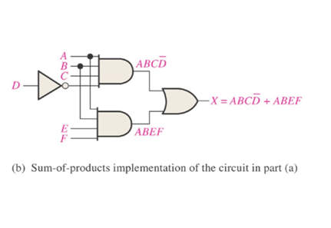
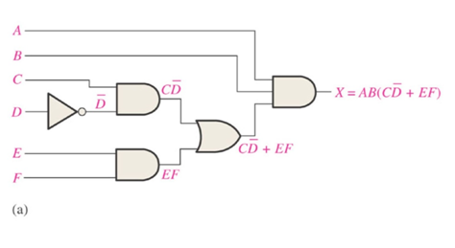
5.2 Implementing Combinational Logic
From a Boolean Expression to a Logic Circuit
Example: Develop a logic diagram to implement

Slide 5
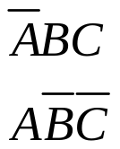
From a Truth Table to a Logic Circuit
Input |  |  | Output | Product Term
A | B | C | X
0 | 0 | 0 | 0
0 | 0 | 1 | 0
0 | 1 | 0 | 0
0 | 1 | 1 | 1
1 | 0 | 0 | 1
1 | 0 | 1 | 0
1 | 1 | 0 | 0
1 | 1 | 1 | 0
ORing the product terms for which X=1

Slide 6
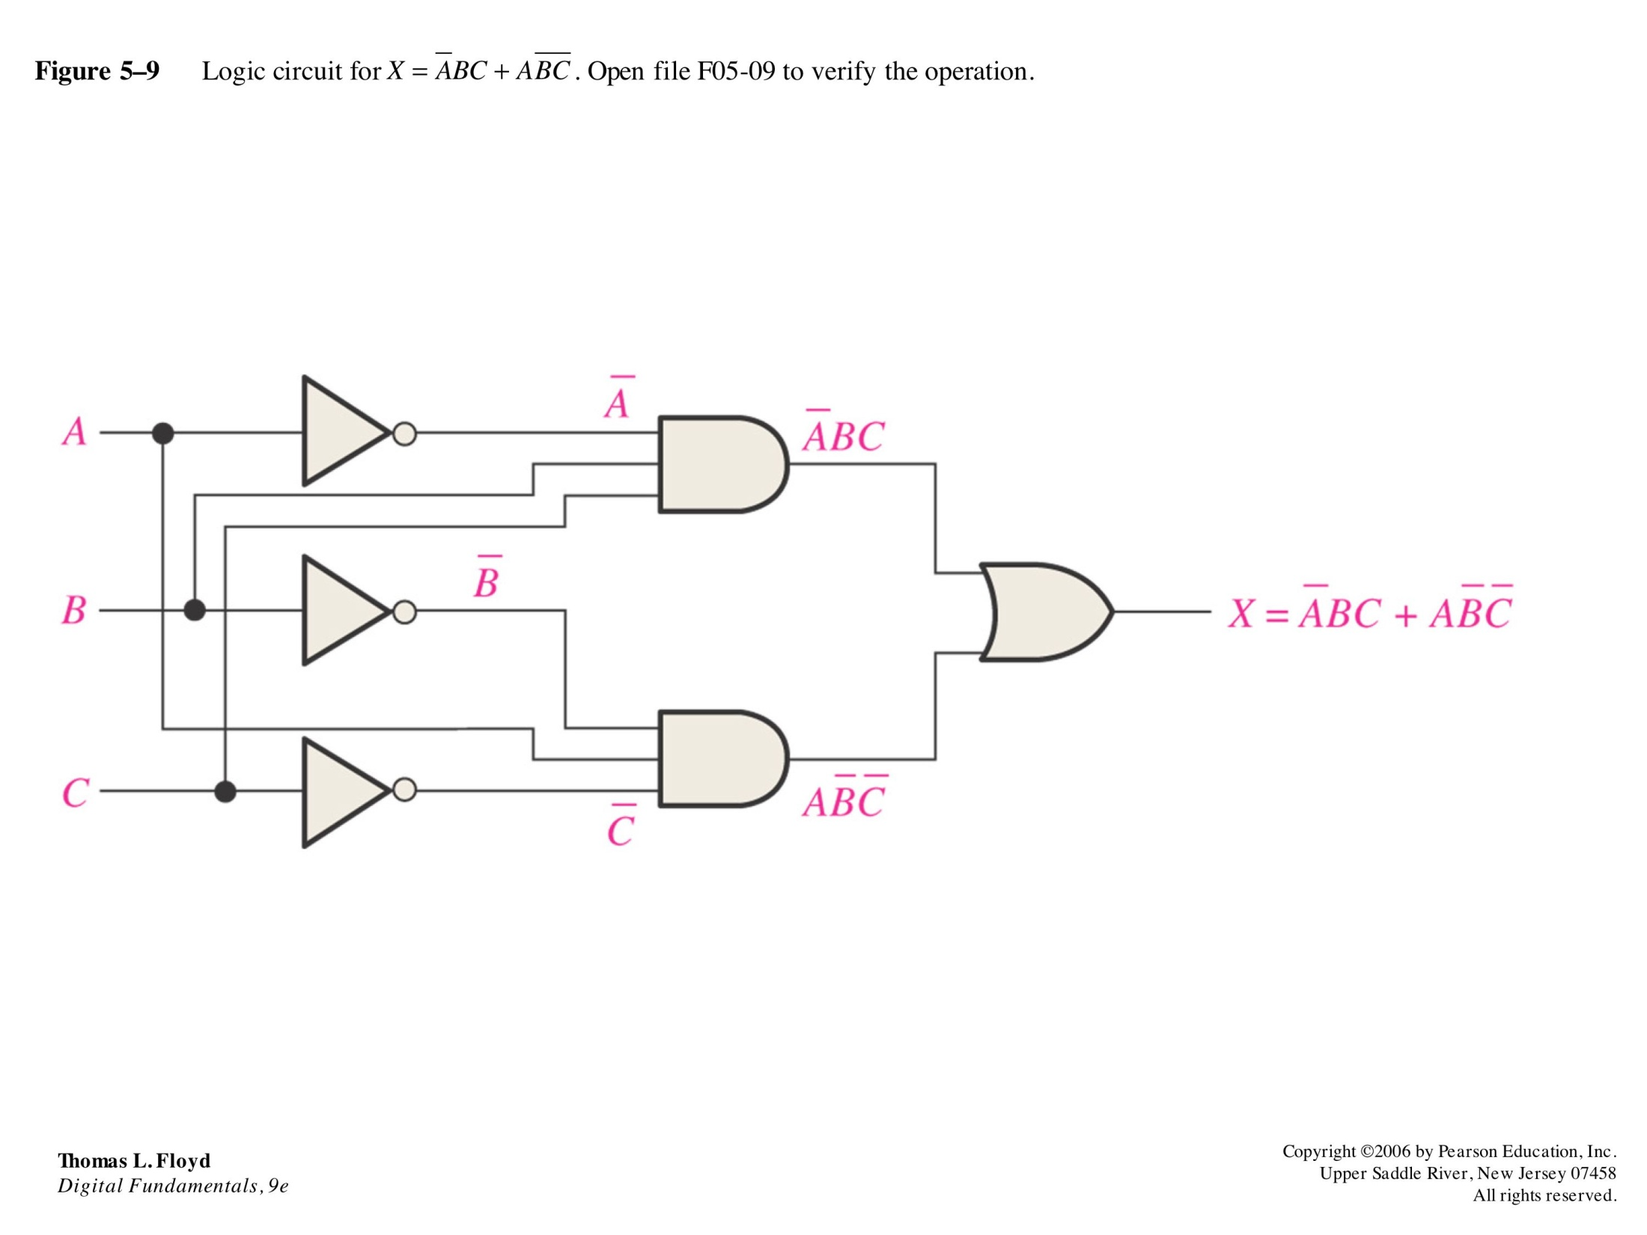
Thomas L. Floyd
Digital Fundamentals, 9e
Copyright ©2006 by Pearson Education, Inc.
Upper Saddle River, New Jersey 07458
All rights reserved.

Slide 7
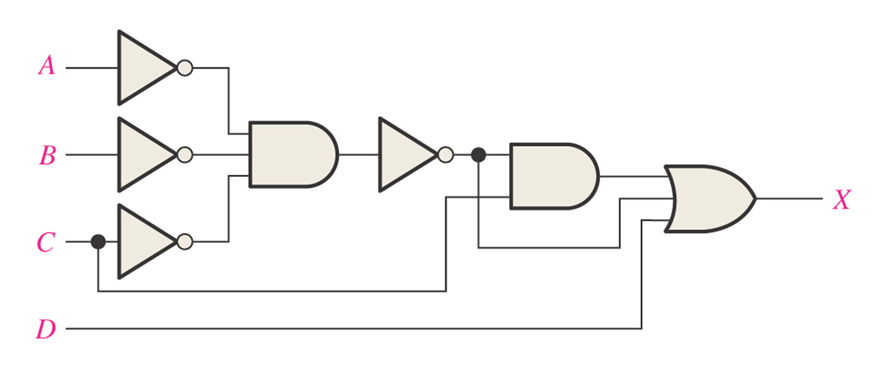
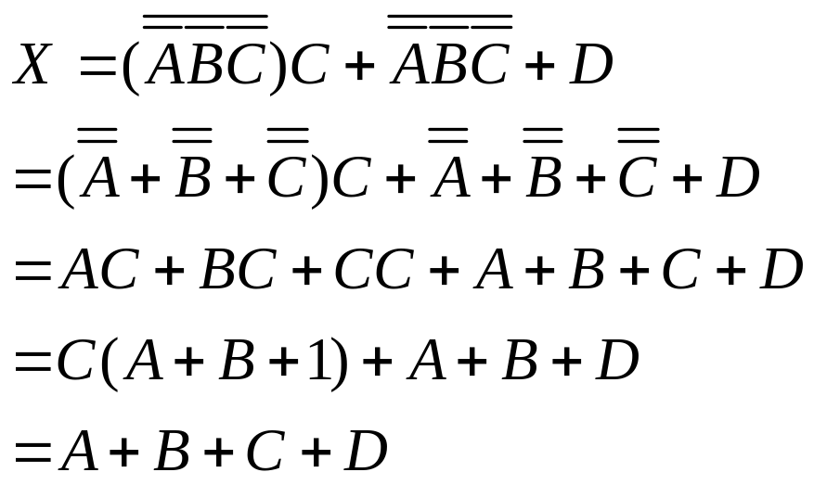
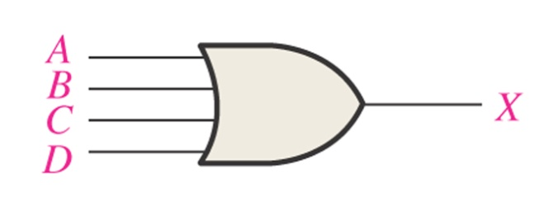
Example: Reduce the combinational logic circuit to a minimum form

Slide 8
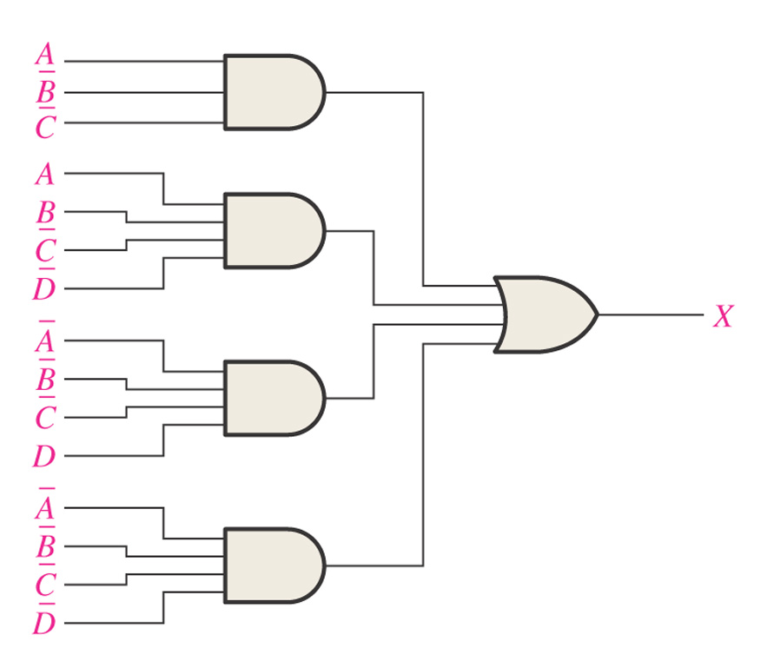
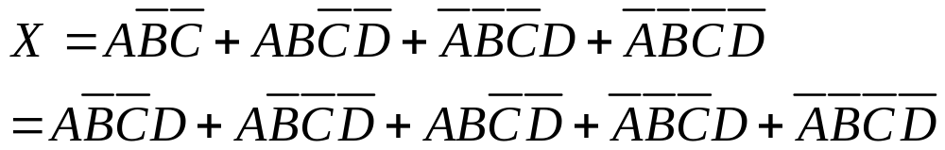
Example: Minimize the combinational logic circuit shown in the following figure.

Slide 9
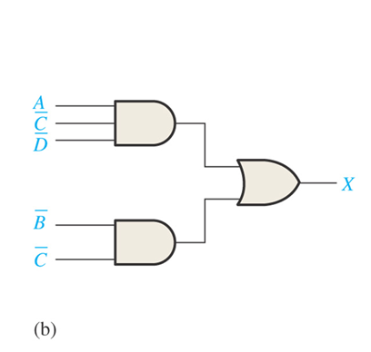
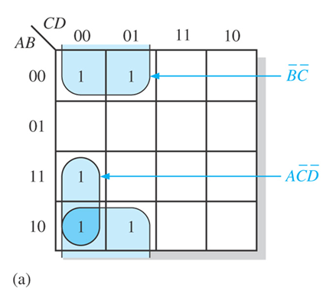


Slide 10
5.3 The Universal Property of NAND and NOR Gates (Homework)
The NAND Gate as a Universal Logic Element
  Be used to produce the NOT, the AND, the OR, and the NOR functions.
The NOR gate as a universal logic element
  Be used to produce the NOT, the AND, the OR, and the NAND functions.

Slide 11
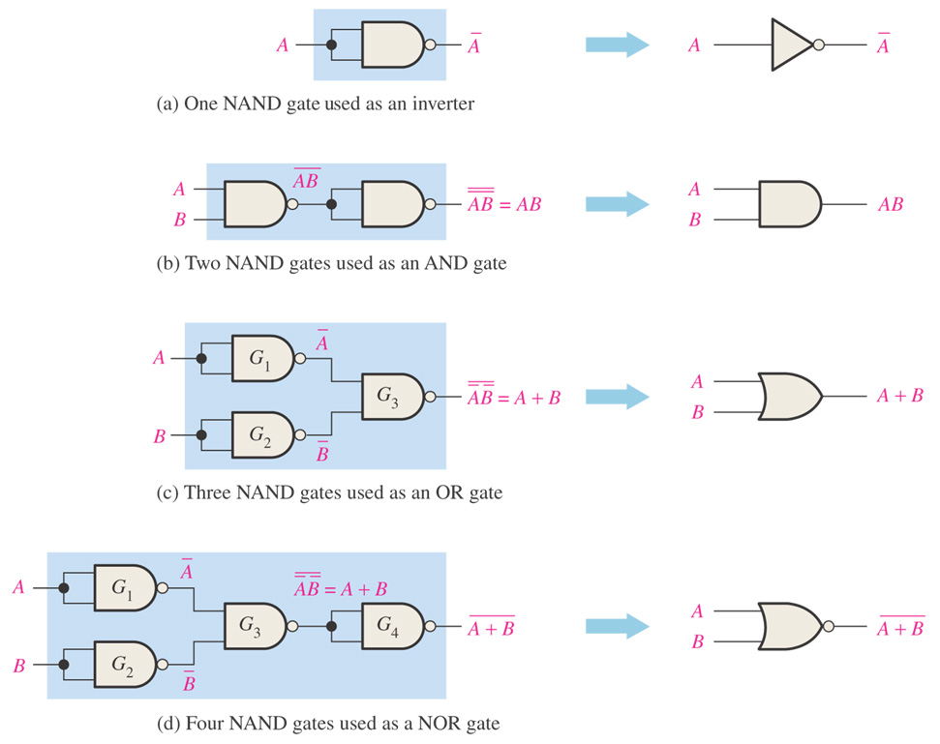

Slide 12
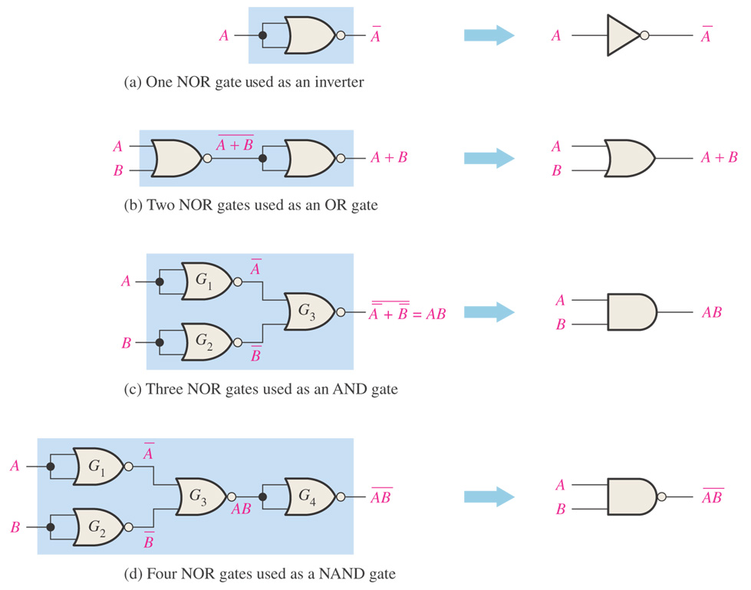

Slide 13


5.4 Combinational Logic Using NAND and NOR Gates
How can NAND and NOR gates be used to implement a logic function?

Slide 14
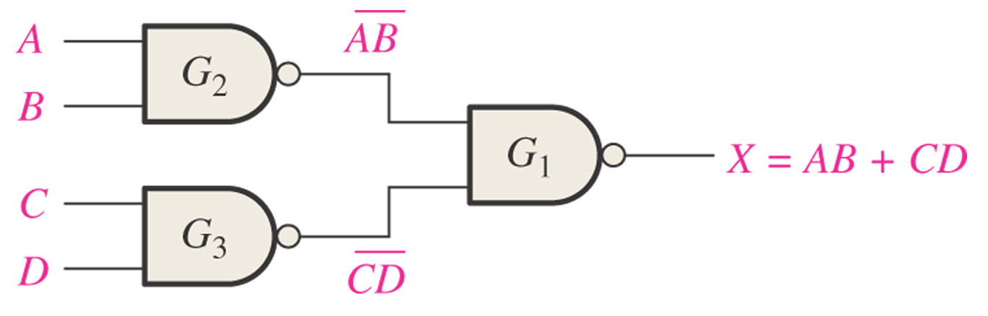
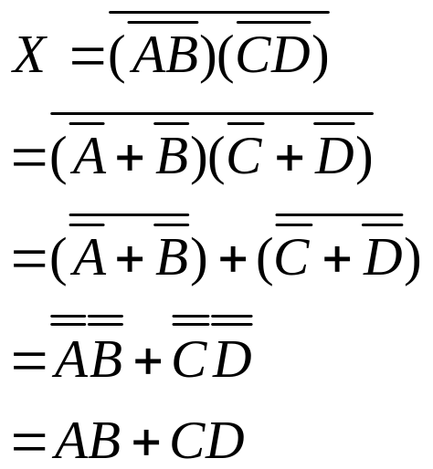
Figure 5–18 NAND logic for X = AB + CD.

Slide 15
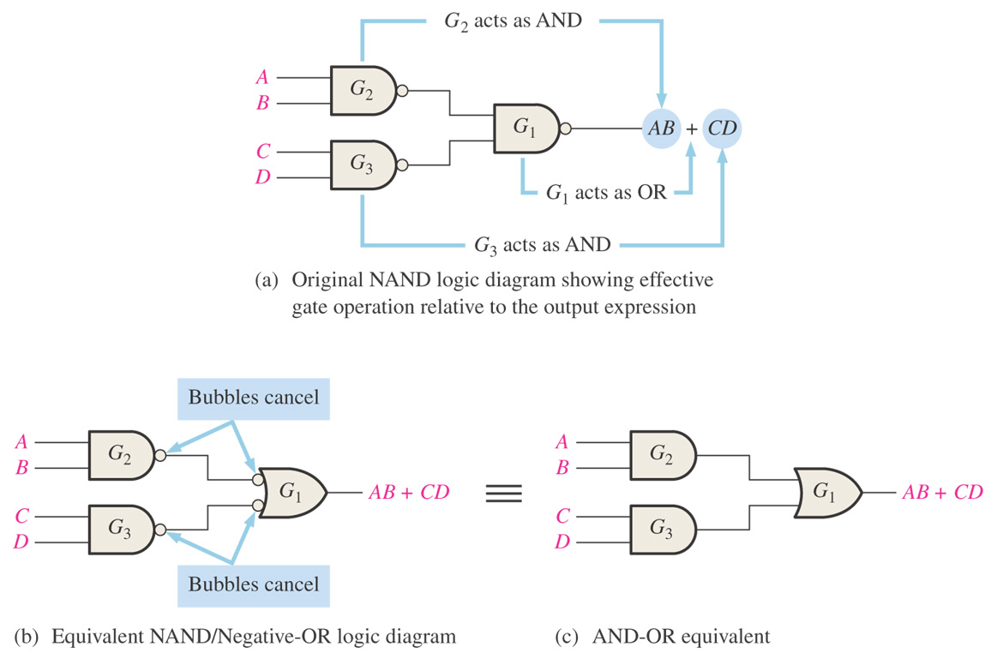

Slide 16
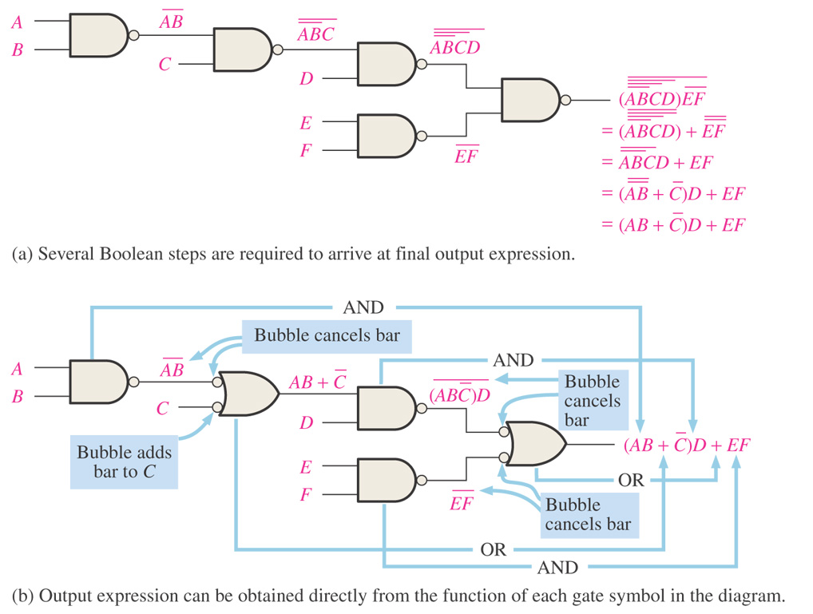

Slide 17
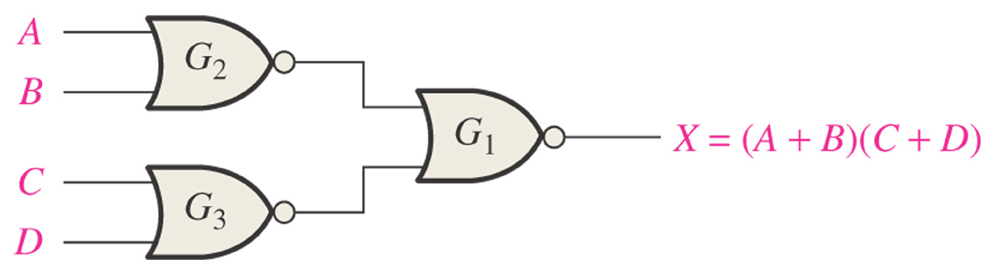
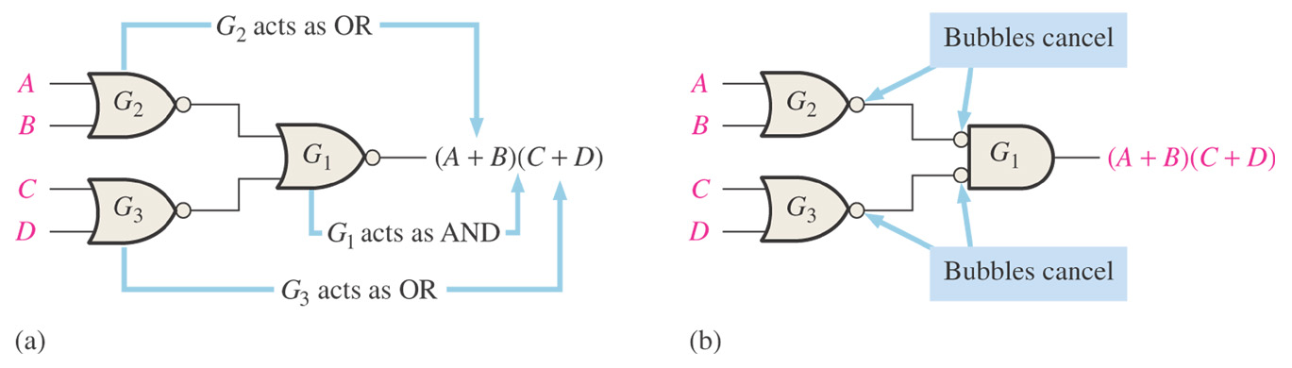
Figure 5–24 NOR logic for X = (A + B)(C + D).

Slide 18
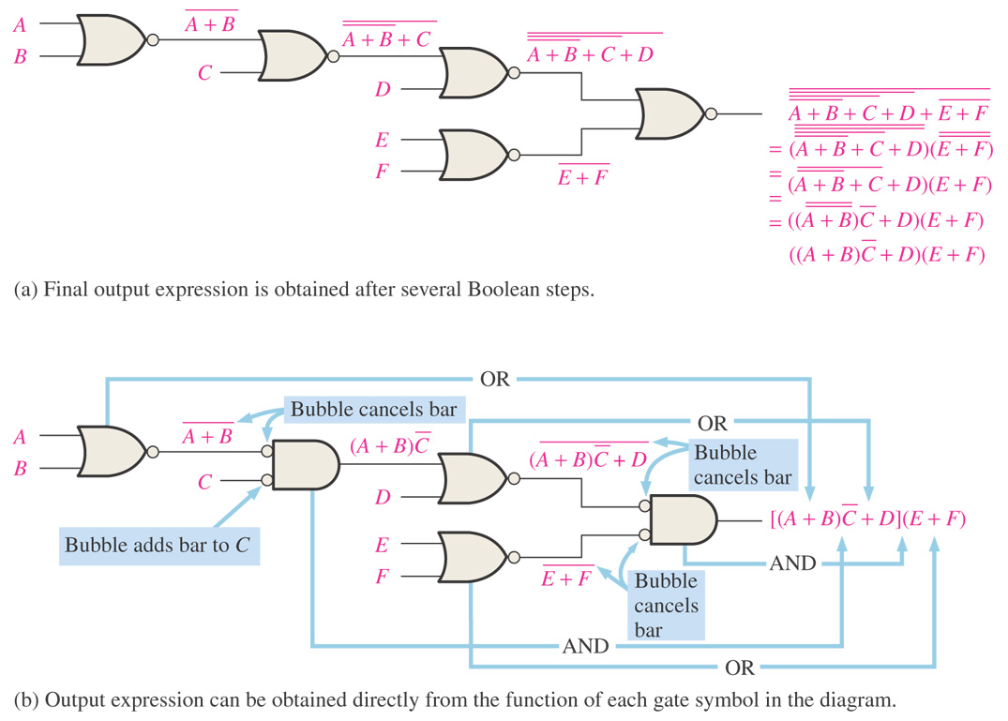

Slide 19
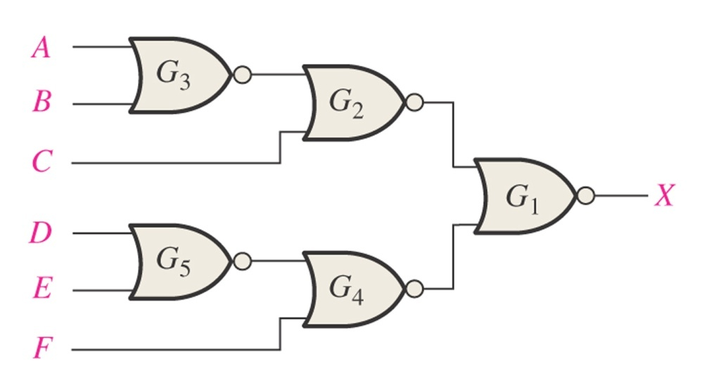
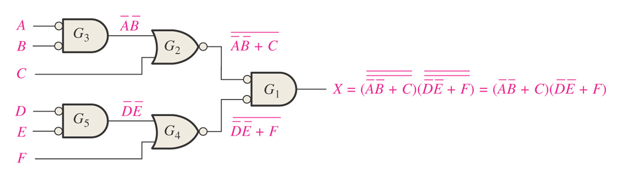
Example: Using appropriate dual symbols, redraw the logic diagram and develop the output expression for the circuit in the following figure.

Slide 20
Summary
Basic Combinational Logic Circuits
Implementing Combinational Logic
  From a Boolean expression to a Logic Circuit
  From a Truth Table to a Logic Circuit
The Universal Property of NAND and NOR Gates
Logic Circuit Operation with Pulse Waveform Inputs
How to design a combinational Logic?

Slide 21
HW
Page 191~193 (Edition 10)
  13
  14
  30

